Slide 1
CSE 201: Digital Logic Design
Prepared By
Lec Sumaiya Afroz Mila
CSE, MIST

Slide 2
BINARY ADDER
The most basic arithmetic operation is the addition of two binary digits.
A combination circuit that performs the addition of two bits is half adder
A adder performs the addition of 2 significant bits and a previous carry is called a full adder

Slide 3
BINARY ADDER
x
+ y
───
C S
Half Adder
Adds 1-bit plus 1-bit
Produces Sum and Carry
x y | C S
0 0 | 0 0
0 1 | 0 1
1 0 | 0 1
1 1 | 1 0

Slide 4
BINARY ADDER
Full Adder
Adds 1-bit(x) plus 1-bit(y) plus 1-bit(z)
Let the bit z be the carry-in bit
Produces Sum and Carry Out
x
+ y
+ z
───
C_{out} S
x y z | C S
0 0 0 | 0 0
0 0 1 | 0 1
0 1 0 | 0 1
0 1 1 | 1 0
1 0 0 | 0 1
1 0 1 | 1 0
1 1 0 | 1 0
1 1 1 | 1 1

Slide 5
BINARY ADDER
x y z | C S
0 0 0 | 0 0
0 0 1 | 0 1
0 1 0 | 0 1
0 1 1 | 1 0
1 0 0 | 0 1
1 0 1 | 1 0
1 1 0 | 1 0
1 1 1 | 1 1
For the combination x=1, y=1 and z=1
─ If we perform the addition operation without considering the input carry (z bit)
─ If we perform the addition operation considering the input carry (z bit)
1
+ 1
───
C_{out} S
1 0
1
+ 1
1
───
C_{out} S
1 1

Slide 6
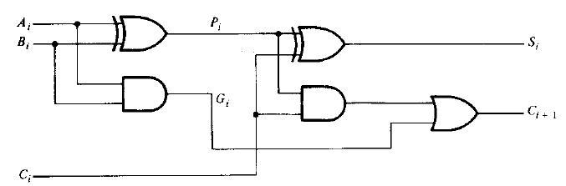
4- bit Parallel Adder using Full Adders
A_{i} B_{i} C_{i} | C_{i+1} S_{i}
0 0 0 | 0 0
0 0 1 | 0 1
0 1 0 | 0 1
0 1 1 | 1 0
1 0 0 | 0 1
1 0 1 | 1 0
1 1 0 | 1 0
1 1 1 | 1 1
0
1
1
0
1 0 1 1
0 0 1 1
1
1
1
0

Slide 7
4- bit Parallel Adder using Full Adders
c₄ c₃ c₂ c₁ c₀
+ A₃ A₂ A₁ A₀
+ B₃ B₂ B₁ B₀
────────────
0
1
1
0
1 0 1 1
0 0 1 1
C₄
S₃
S₂
S₁
S₀
1
1
1
0
C₄
C₃
C₂
C₁

Slide 8
4- bit Parallel Adder using Full Adders
A₃
A₂
A₁
A₀
B₃
B₂
B₁
B₀
C₀=0
FA
FA
FA
FA
C₄
S₃
C₃
S₂
C₂
S₁
C₁
S₀
Carry Propagate Addition
c₄ c₃ c₂ c₁ c₀
+ A₃ A₂ A₁ A₀
+ B₃ B₂ B₁ B₀
────────────
C₄
S₃
S₂
S₁
S₀
C₄
C₃
C₂
C₁

Slide 9
4- bit Parallel Adder using Full Adders
1
0
1
1
0
0
1
1
C₀=0
FA
FA
FA
FA
C₄
S₃
S₂
S₁
S₀
C₃
C₂
C₁
0
1
0
1
1
1
1
0
0 0 1 1 0
+ 1 0 1 1
+ 0 0 1 1
────────────
Carry in
A
B
0
1
1
1
0
Sum
0
0
1
1
Carry out

Slide 10
4- bit Parallel Adder Diagram
Input Terminals
B₃ B₂ B₁ B₀
A₃ A₂ A₁ A₀
4-bit parallel adder
C₅
C₀
S₃ S₂ S₁ S₀
Output Terminals

Slide 11
BINARY SUBTRACTOR
The subtraction operation (A-B) can be done by (A+ 2’s complement of B)
Take 1’s complement or invert of B
Add A with 1’s complement of B
Add 1 with the least significant bits of the previous addition
This can be achieved by modifying the n-bit parallel adder by
adding an inverter in input of B
Input carry C₀ must be equal to 1
For unsigned numbers-
This operation gives (A-B) if A ≥ B
And 2’s complement of B-A if A≤B

Slide 12
4- bit Parallel Subtractor using Full Adders
A₃
A₂
A₁
A₀
B₁
B₀
B₃
B₂
C₀=1
FA
FA
FA
FA
C₄
S₃
C₃
S₂
C₂
S₁
C₁
S₀
A₃ A₂ A₁ A₀
+B’₃B’₂B’₁B’₀
+ 1

Slide 13
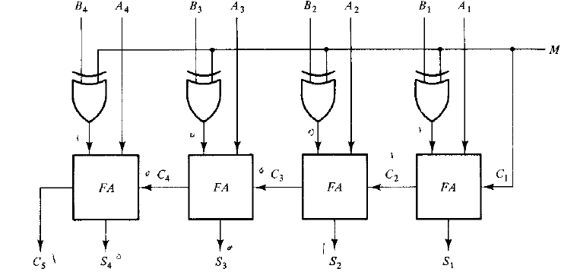
4- bit Adder - Subtractor

Slide 14
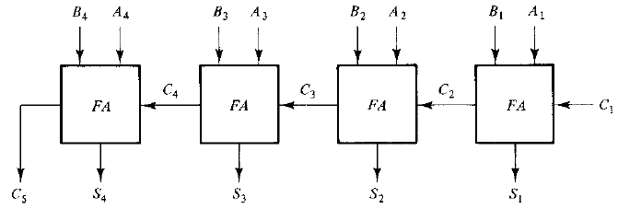
Limitations in Parallel Adder
Input A₄ & B₄ reach steady state as soon as input signals are applied to the adder
But C₄ does not settle to its steady state until C₃ is available
For S₂ to be in steady state, A₂,B₂ and carry C₂ must be available
When these 3 bits are available, sum bit S₁ will be in steady state
For S₄ to be in steady state, A₄,B₄ and carry C₄ must be available
All bits of addend and augend should be available for computation at the same time
Each bit of sum output depends on the value of the input carry
Similarly C₃ has to wait for C₂, and C₂ has to wait for C₁
Thus only after the carry propagates through all the stages, S₄ will be in its steady state

Slide 15
Limitations in Parallel Adder
Carry propagation from C1 to C4 causes propagation delay
The signal from the input carry C_{i} to the output carry C_{i+1}, propagates through an AND gate+ an OR gate, means two gate levels.
C₂ has 2 gate levels from C₁ to C₂
C3 has 2 gate levels from C₂ to C₃ and 4 gate levels from C₁ to C₃
Similarly, in the previous design with 4 full adders, C₅ has 4*2=8 gate levels from C₁ to C₅
So, the total propagation time would be, propagation time in one half adder plus 8 gate levels

Slide 16
Limitations in Parallel Adder
Carry propagation time is a limiting factor on the speed
Though the parallel adder will always have some value in the output terminals, outputs will not be correct unless signals are given enough time to propagate through the gates connected from the inputs to the outputs
One technique to reduce the carry propagation time is look-ahead carry

Slide 17

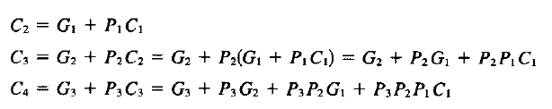

LOOK-AHEAD CARRY
Booelan Function for carry output of each stage:
Output sum and carry can be expressed as:
C₅ can be derived by the equation substitution method:
C₅ = G₄+P₄C₄
= G₄ + P₄(G₃+P₃G₂+P₃P₂G₁+P₃P₂P₁C₁)

Slide 18
LOOK-AHEAD CARRY
Boolean function for each output carry is expressed in sum of products.
Each function can be implemented with one level of AND gate, followed by an OR gate.
Carry outputs depend on the variable P and G. P_{i} and G_{i} are functions of input A_{i} and B_{i} which are available as soon as inputs are applied to the adder.
In this design, C₄ does not have to wait for C₃ and C₂ to propagate.
In fact, C₄ is propagated at the same time as C₃ and C₂

Slide 19
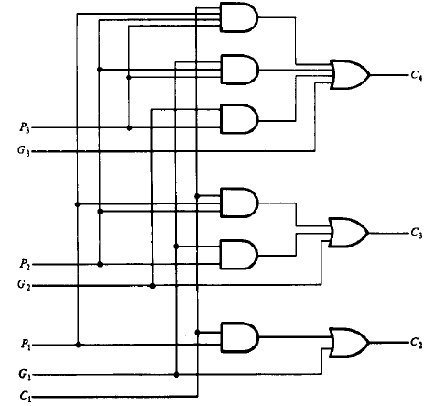
LOOK-AHEAD CARRY
C₅ = G₄+P₄C₄
= G₄ + P₄(G₃+P₃G₂+P₃P₂G₁+P₃P₂P₁C₁)
Connection of C₅ is not shown here.
However, we can add the connection for C₅

Slide 20




4-BIT FULL ADDERS WITH LOOK-AHEAD CARRY
we have to add the connection for C₅ here
We can hide the complex circuit of Look-ahead carry and replace it with this box.
S_{i} = P_{i} xor C_{i}
S₁ = P₁ xor C₁
S₂ = P₂ xor C₂
S₃ = P₃ xor C₃
S₄ = P₄ xor C₄

Slide 21
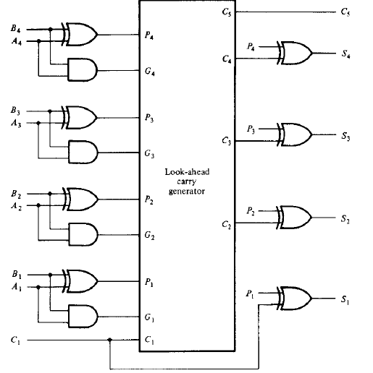
4-BIT FULL ADDERS WITH LOOK-AHEAD CARRY
So, the new design can be drawn like this

Slide 22
Logic Circuits
Logic Circuits: Combinational and Sequential
Combinational Circuits
A combinational circuit consists of logic gates whose outputs at any time are determined from only the present combination of inputs.
Sequential Circuits
A sequential circuits employ storage elements and logic gates.
The outputs are a function of the inputs and the state of the storage elements.
The state of the storage elements, in turn, is a function of the previous inputs (and the previous state).

Slide 23
BINARY CODED DECIMAL
Binary coded decimal (BCD) is a system of writing numerals that assigns a four-digit binary code to each digit 0 through 9 in a decimal (base-10) numeral.
Numbers larger than 9, having two or more digits in the decimal system, are expressed digit by digit. For example, the BCD rendition of the number 1895, (base-10) is
Decimal | BCD | Binary
0 | 0000 | 0000
1 | 0001 | 0001
2 | 0010 | 0010
3 | 0011 | 0011
4 | 0100 | 0100
5 | 0101 | 0101
6 | 0110 | 0110
7 | 0111 | 0111
8 | 1000 | 1000
9 | 1001 | 1001
0001 1000 1001 0101

Slide 24
BCD ADDER
We will perform addition operation of two decimal numbers in BCD
Each input does not exit 9
Sum output will be highest: 19
The binary value and BCD value of the augend and addend are same
Apply the BCD value of the augend and the addend to a 4-bit binary adder
Adder will form the sum in binary and produce a result that may range from 0 to 19
This binary result should be converted to BCD
9(augend)
+9(addend)
+1(input carry)
19

Slide 25
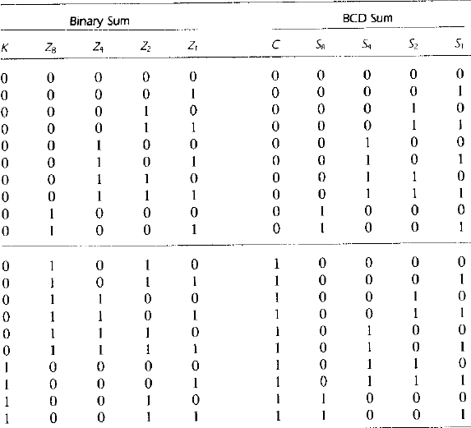
BCD ADDER

Slide 26
BCD ADDER
From the table, when binary sum ≤ 1001(9₁₀), corresponding BCD is identical – No conversion needed
When binary sum > 1001, it becomes non-valid as BCD – conversion needed
For binary sum>1001, we have to convert it to a valid BCD representation
When binary sum is 1010, decimal is 10 – correct BCD representation will be
To convert 1010 to 10000, we have to add (0110)₂ or (6)₁₀ with 1010
Similarly if we add (0110)₂ or (6)₁₀ with 1011……10011, we will get the corresponding BCD representation
0001 0000

Slide 27
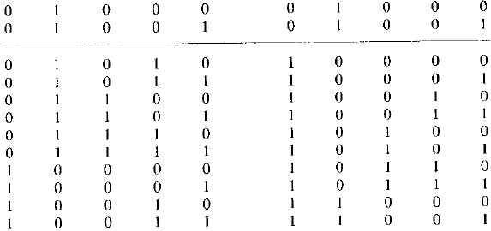
BCD ADDER
Now we have to design the circuit.
We have to design a circuit that will detect when conversion should be performed and when not.
From the table, it is
visible that, conversion
is needed when the
binary sum has an
output carry K=1.
Other 6 combinations
From 1010 to 1111 that
Need conversion have a 1 in position z8
To distinguish them form the value 1000 and 1001 (also have a 1 in position Z8), we specify, either Z₄ or Z₂ must have a 1
C = K + Z₈Z₄ + Z₈Z₂
K Z₈ Z₄ Z₂ Z₁ C S₈ S₄ S₂ S₁

Slide 28
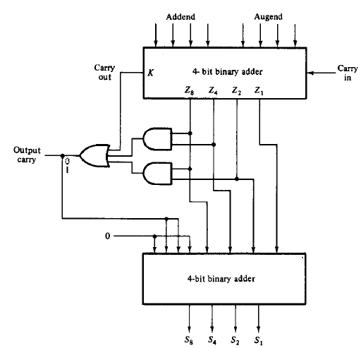
BCD ADDER
When C = K + Z₈Z₄ + Z₈Z₂ ,it is necessary to add 110 to the binary sum and provide an output carry for the next stage
To add 0110 to the binary sum, we use a second 4-bit binary adder
First the augend, added
and the input carry are
added in the top 4-bit binary adder
to produce the binary sum
When output carry=0 nothing
added
When output carry=1,binary 0110
is added to the binary sum through the
bottom 4-bit binary adder

Slide 29
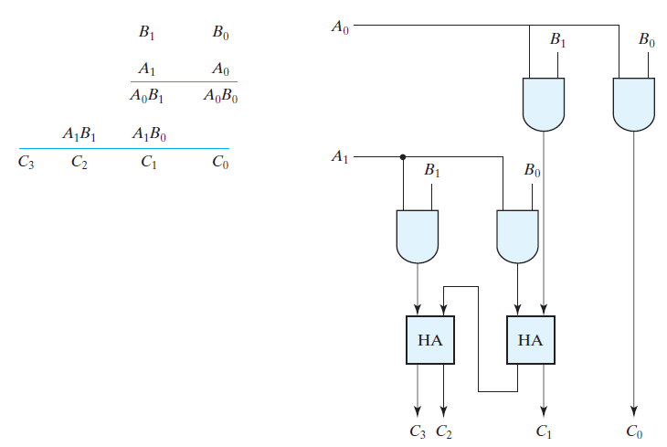
2- BIT by 2-BIT BINARY MULTIPLIER

Slide 30
MAGNITUDE COMPARATOR
Magnitude Comparator: A magnitude comparator is a combinational circuit that compares two numbers A and B, and determines their relative magnitudes. The outcome of the comparison is specified by three binary variables that indicate whether A=B , A>B , or A<B
The circuit for comparing two n-bit numbers has 2^{2n} entries in the truth table and becomes too cumbersome even with n=3.
So, we will develop an algorithm to design a comparator

Slide 31
MAGNITUDE COMPARATOR
We will consider two 4-bit numbers:
A = A₃A₂A₁A₀
B = B₃B₂B₁B₀
The two numbers are equal if all pairs of significant digits are equal. If A₃=B₃ & A₂=B₂ & A₁=B₁ & A₀=B₀
So the equality relation of each pair of bits will be
x_{i} = A_{i}B_{i}+A_{i}’+B_{i}’ , where x_{i}=1 only if the pair of bits in position i are equal
If all pair of bits of A and B are equal which means, if X₃X₂X₁X₀ all are equal 1, we can say A=B

Slide 32
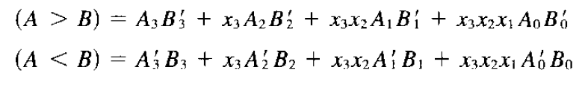
MAGNITUDE COMPARATOR
To determine if A>B or A<B, we inspect relative magnitudes of significant bits starting from the MSB
If these two bits are equal, we compare the next lower significant pair of bits
This comparison continues until a pair of unequal digits is reached
If the corresponding digit of A=1 and that of B=0, we conclude A>B
If the corresponding digit of A=0 and that of B=1, we conclude A<B
The boolean function for the above sequential comparison will be:
A₃ A₂ A₁ A₀
B₃ B₂ B₁ B₀
1 1 1
1 1 0 1
1 0 1
1 1 1 1

Slide 33
MAGNITUDE COMPARATOR
If A₃B₃’ = 1, A>B
A₃ A₂ A₁ A₀
B₃ B₂ B₁ B₀
1 1 1
0 1 0 1
1 0 1
1 0 1 1
If X₃A₂B₂’ = 1, A>B
1 1 1
1 1 0 1
If X₃X₂A₁B₁’ = 1, A>B
If X₃X₂X₁A₀B₀’ = 1, A>B
1 1 1
1 1 1 0

Slide 34
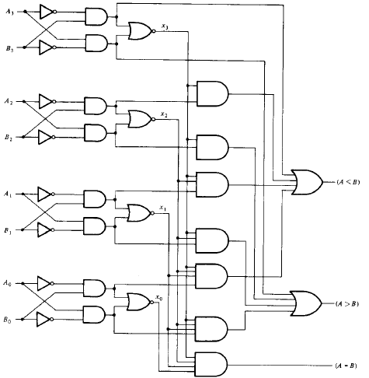
MAGNITUDE COMPARATOR

Slide 35
MAGNITUDE COMPARATOR
x_{i} = A_{i}B_{i}+A_{i}’+B_{i}’
(A₀’B₀+A₀B₀’)’ = (A₀ xor B₀)’
= A0 xnor B0
= A₀B₀+A₀’B₀’

Slide 36
DECODER
A decoder is a combinational circuit that converts binary information from n-input lines to a maximum 2^{n} unique output lines.
If the n-bit decoded information has unused or don’t care combinations, the decoder output will have fewer than 2^{n} outputs
This decoders are called n-to-m-line decoders, where m ≤ 2^{n}
1-to-2-Line Decoder -

Slide 37
2-to-4 Line Decoder
The 2 inputs are decoded into 4 outputs
Each output represents one of the
minterms of the 2-input variables
2 intverters provide the complement of
the inputs
Each one of the 4 AND gates generate one
of the minterms
D₃
D₂
D₁
D₀
A B | D₃ | D₂ | D₁ | D₀
0 0 | 0 | 0 | 0 | 1
0 1 | 0 | 0 | 1 | 0
1 0 | 0 | 1 | 0 | 0
1 1 | 1 | 0 | 0 | 0

Slide 38
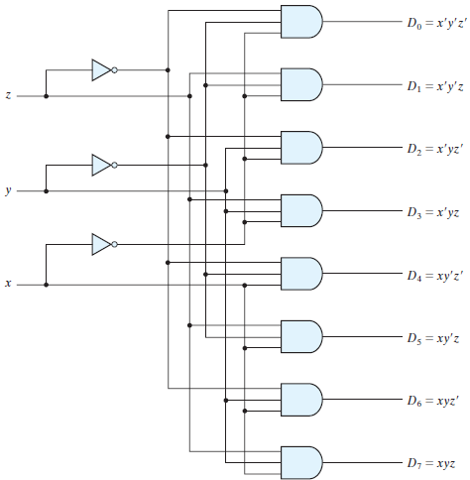
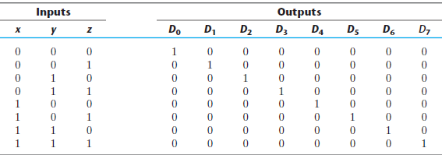
3-to-8 Line Decoder
3 inputs are decoded into 8 outputs
Each output represents
one of the minterms of the
3-input variables
3 intverters provide the
complement of the inputs
Each one of the 8 AND
gates generate one of the minterms

Slide 39
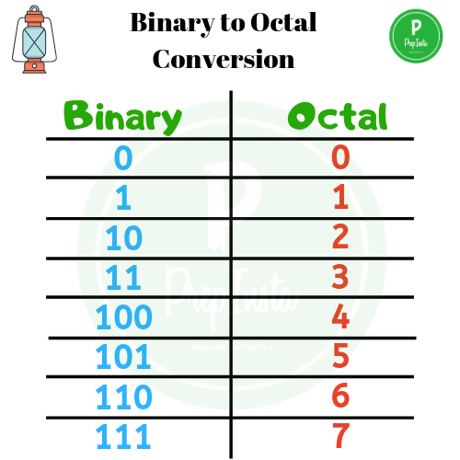
3-to-8 Line Decoder
A particular application of this decoder
is binary-to-octal conversion.
The input variables represent
a binary number
The outputs represent the
eight digits of a number in
octal number system

Slide 40
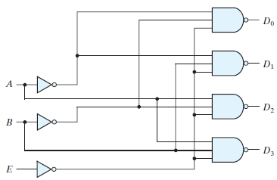
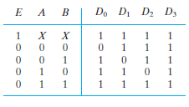
2-to-4 Line Decoder with enable input
Some decoders are constructed with NAND gates
May include one or more Enable inputs to control the circuit operation
Circuit operates with complemented output
and complement enable input
The decoder is enabled when E=0
Circuit is disabled when E=1
When circuit is disabled, none of the outputs are equal to 0 and none of the minterms are selected
At any given time, only one output is equal to 0, other outputs are 1
0

Slide 41
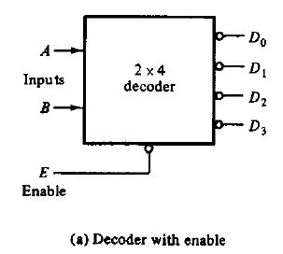
Decoder
A decoder can operate with complemented or uncomplemented output
Enable input may be activated with a 0 or a 1 signal
Some decoders may have two or more enable inputs
Block diagram of the 2-to-4 line decoder -

Slide 42
COMBINATIONAL LOGIC IMPLEMENTATION
A decoder produces 2^{n} minterms of n-inputs
Any boolean function can be expressed in sum of minterms form
So, a decoder can be used to generate minterms, and an external OR gate to form the sum
Any combinational circuit can be implemented with a decoder and OR gates
Implementing a combinational circuit with a decoder and OR gates requires the boolean function of the circuit be expressed in sum of minterms

Slide 43
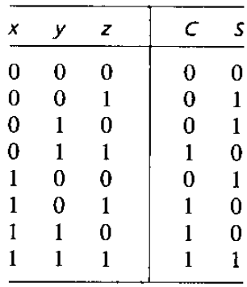
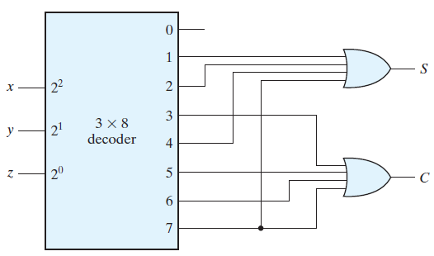
IMPLEMENTING FULL ADDER USING DECODER
From the table of the full-adder, function for this circuit in sum of minterms:
S = X’Y’Z + X’YZ’ + XY’Z’ + XYZ or S(x, y, z) = ∑(1, 2, 4, 7)
C = X’YZ + XY’Z + XYZ’ + XYZ or C(x, y, z) = ∑(3, 5, 6, 7)
Full-adder circuit has 3 inputs and total 8 outputs, we need 3-to-8-line decoder
Decoder generates the 8 minterms for x,y,z
The OR gate for output S forms the sum of minterms 1,2,4 and 7
The OR gate for output C forms the sum of minterms 3,5,6,and 7

Slide 44
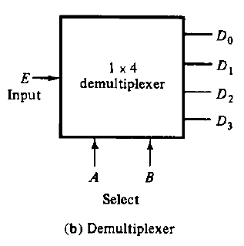
DEMULTIPLEXER
Demultiplexer: A demultiplexer is a circuit that receives information from a single line and transmits this information it to one of 2^{n} possible output lines.
The selection of a specific output is controlled by the bit combination of n selection lines.
The decoder can function as 1-to-4-line demultiplexer when E is taken as a data input line and A and B are taken as the selection inputs.

Slide 45
DEMULTIPLEXER
The single input variable E has a path to all four outputs, but the input information is directed to only one of the output lines, as specified by the binary combination of the two selection lines A and B
Example, if the selection lines AB = 10, output D₂ will be the same as the input value E , while all other outputs are maintained at 1.
As decoder and demultiplexer operations are obtained from the same circuit, a decoder with an enable input is referred to as a decoder – demultiplexer

Slide 46
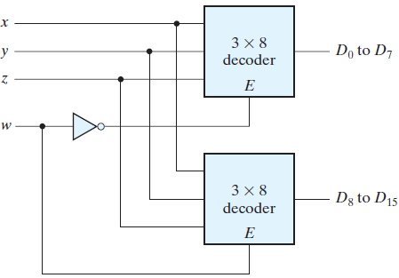
DECODER EXPANSION
Decoder/ Demultiplexer can be connected together to form a larger decoder circuit
Example, two 3-to-8-line decoders with enable inputs connected to form a 4-to-16-line decoder
When w = 0, the top decoder is enabled and the other is disabled.
The bottom decoder outputs are all 0’s, and the top eight outputs generate minterms 0000 to 0111.
When w = 1, the enable conditions are reversed: The bottom decoder outputs generate minterms 1000 to 1111, while the outputs of the top decoder are all 0’s.

Slide 47
ENCODER
Does reverse operation to decoder
An encoder has 2^{n} (or fewer) input lines and n output lines
Constraint – only one input is active at a time
An encoder is a digital circuit that has 2^{n} or fewer input lines and n output lines. The output lines generate the binary code corresponding to the input value
Example – Octal to binary encoder
Has 8 inputs, one for each octal digit
3 outputs, that generates the corresponding binary number
It is assumed that, only one input has a value of 1 at a given time

Slide 48
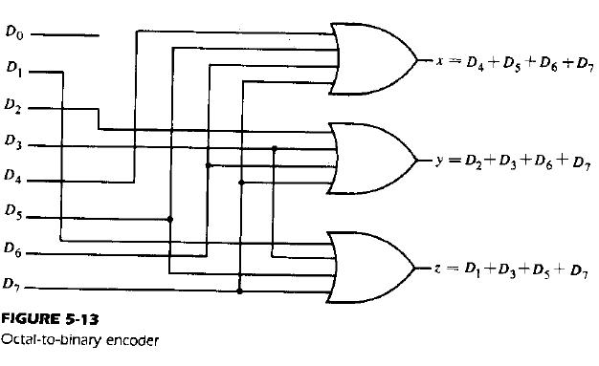
ENCODER
Binary Encoder
D₇ D₆ D₅ D₄ D₃ D₂ D₁D₀ | X Y Z
0 0 0 0 0 0 0 1 | 0 0 0
0 0 0 0 0 0 1 0 | 0 0 1
0 0 0 0 0 1 0 0 | 0 1 0
0 0 0 0 1 0 0 0 | 0 1 1
0 0 0 1 0 0 0 0 | 1 0 0
0 0 1 0 0 0 0 0 | 1 0 1
0 1 0 0 0 0 0 0 | 1 1 0
1 0 0 0 0 0 0 0 | 1 1 1
D₇
D₆ D₅
D₄ D₃
D₂
D₁
D₀
X
Y
Z
Octal to Binary encoder truth table

Slide 49
ENCODER
Limitations of the previous encoder –
Only one input can be active at any given time: If two inputs are active simultaneously, output produces undefined combination. I.e. If D₃ and D₆ are active at the same time, output of the encoder will be 111 which is neither binary 3 nor binary 6. To solve this limitation, priority encoder is introduced.
When all the inputs are 0, output of the encoder will be 000. Again, output of the encoder will be 000 if D₀ is equal to 1. This can be resolved by providing an additional output indicating that none of the inputs are active.

Slide 50
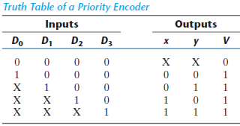
PRIORITY ENCODER
A priority encoder is a special type of encoder circuit that includes priority function
Multiple inputs maybe active at the same time
Highest priority input gets the precedence
D₃ has the highest priority, then D₂ has the
second highest priority and so on.
When input D₃ is equal to 1, regardless of the
values of the other inputs, output for XY will be 11(binary 3)
As D₂ has the second highest priority level, when D₂ = 1, regardless of the values of the other two lower priority inputs(D₁ and D₀), the output for XY will be 10, given that D₃ must be equal to 0
A Valid-output indicator, set to 1 when one or more of the inputs are active
When all inputs are inactive, V=0, other two outputs of the circuit are not used

Slide 51
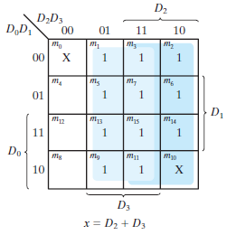
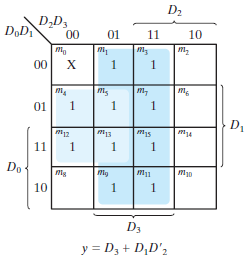

PRIORITY ENCODER
Priority Encoder
D₃
D₂
D₁
D₀
V
Y
X

Slide 52
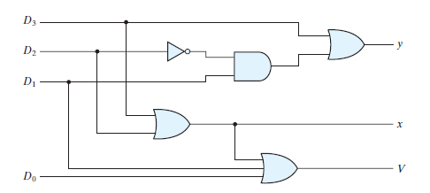
PRIORITY ENCODER

Slide 53
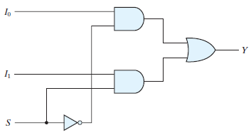
MULTIPLEXER
A digital multiplexer is a combinational circuit that selects binary information from one of many input lines and directs it to a single output line
There are n selection lines whose bit combinations determine which input is selected.
Generally there are 2^{n} input lines, n selection lines
Each of the two input lines I₀ and I₁
applied to one input of an AND gate
Selection line S decoded to select a
particular AND gate
2 to 1 line multiplexer

Slide 54
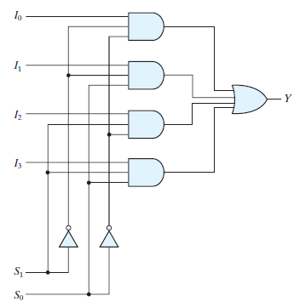

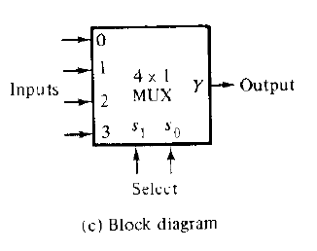
4 to 1 LINE MULTIPLEXER
In this circuit, there are 4 input lines, 2 selection lines
Each of the four input lines I₀ to I₃ applied to one input of an AND gate
Selection lines S₁ and S₀ decoded to select a
particular AND gate
Function table of a 4 to 1 line multiplexer
Block diagram of a 4 to 1 line multiplexer
4 to 1 line multiplexer

Slide 55
4 to 1 LINE MULTIPLEXER
When S₁S₀=10, AND gate associated with I₂ has two of its input equal to 1 and the third input is connected to I₂.
Other 3 AND gates has atleast one input equal to 0,
making their output equal to 0
The OR gate output is now equal to the value of I₂
Function table of a 4 to 1 line multiplexer
Block diagram of a 4 to 1 line multiplexer
4 to 1 line multiplexer

Slide 56
FUNCTION IMPLEMENTATION USING MUX
Any boolean function can be implemented by using a multiplexer
A boolean function of n+1 variables can be implemented by taking n variables to the selection lines of the multiplexer.
The remaining variable is used as the input line for the multiplexer
Example- F(A, B, C) = ∑(1, 3, 5, 6)
Steps:
Choose the selector variables. Lets choose,
B, C as selector S₁ and S₀
A as input line

Slide 57
FUNCTION IMPLEMENTATION USING MUX
Example- F(A, B, C) = ∑(1, 3, 5, 6)
Steps:
In the first row, list the name of the input lines of the multiplexers horizontally
In the second row, list the minterms where A is complemented
In the third row, list the minterms where A is uncomplemented
Circle the minterms for which the function outputs 1
Fourth row presents the multiplexer inputs
If the two minterms in a column are not circled, apply 0 to the corresponding multiplexer input
If the two minterms in a column are circled, apply 1 to the corresponding multiplexer input
If the bottom minterm is circled and the top is not circled, apply A to the corresponding multiplexer input
If the top minterm is circled and the bottom is not circled, apply A’ to the corresponding multiplexer input

Slide 58
FUNCTION IMPLEMENTATION USING MUX
F(A, B, C) = ∑(1, 3, 5, 6)
4x1 MUX
0
I₀
I₁
I₂
I₃
MUX input line | I₀ | I₁ | I₂ | I₃
A’ | 0 | 1 | 2 | 3
A | 4 | 5 | 6 | 7
Input values | 0 | 1 | A | A’
1
S₁ S₀
A B C

Slide 59
FUNCTION IMPLEMENTATION USING MUX
F(A, B, C) = ∑(1, 2, 4, 5)
4x1 MUX
I₀
I₁
I₂
I₃
1
MUX input line | I₀ | I₁ | I₂ | I₃
A’ | 0 | 1 | 2 | 3
A | 4 | 5 | 6 | 7
Input values | A | 1 | A’ | 0
0
S₁ S₀
A B C

Slide 60

FUNCTION IMPLEMENTATION USING MUX
It is not necessary to choose the leftmost variable in the ordered sequence of a variable list for the data inputs of the multiplexer. Any of the variable can be chosen to be the input
F(A, B, C) = ∑(1, 2, 4, 5)
4x1 MUX
Z
I₀
I₁
I₂
I₃
MUX input line | I₀ | I₁ | I₂ | I₃
Z’ | 0 | 2 | 4 | 6
Z | 1 | 3 | 5 | 7
Input values | Z | Z’ | 1 | 0
1
0
S₁ S₀
X Y

Slide 61
Self Study
Why is a multiplexer called data selector?
Logic diagram of a quadruple 2 to 1 line multiplexer.(177PAGE)
Exercises from chapter 5:
5-17,5-18,5-20,5-23,5-24(book slide 208)
Implement the following function with a multiplexer
F(A, B, C,D) = ∑(0,1, 3, 4, 8,9,15)

